Slide 1

By:
Sharat Babu Jami

Slide 2
What do it do?
The company primarily focuses on mobile gaming, offering the games on mobile devices, including smartphones and tablets on Apple’s iOS and Google’s Android operating systems, and on social networking platforms such as Facebook.
Zynga states its mission as "connecting the world through games.“
With $741.4 million revenues, Zynga ranked number 33 of all the companies in the US Internet industry.
Revenue is driven in by
development of games(captilization of $3.39million(1681 emp))
In March 2010 Zynga started selling prepaid cards for virtual currency at more than 12,800 stores across the US.
Shares of the company(costs $4 for Share)
Major costs
development cost
advertisement cost

Slide 3
Processes
B2B
B2C
Functions

Slide 4
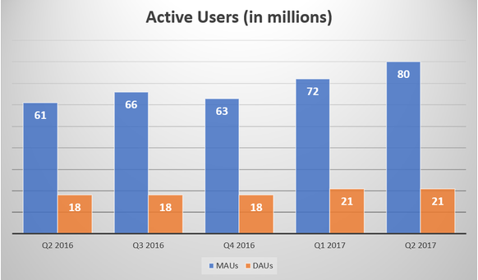
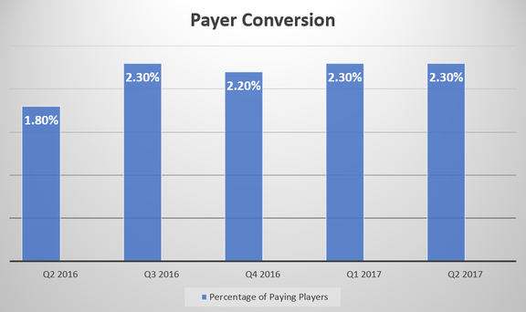
Important KPI &Metrices
Mobile revenue growth
Active no.of user per day/month
Payer conversion
Ad Revenue
Relation between sales and margins

Slide 5
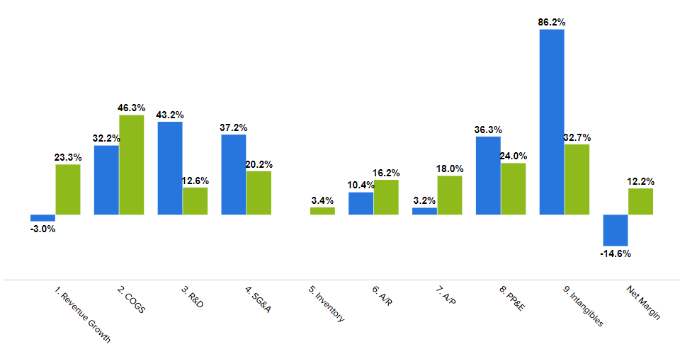
Analysis is implemented in
Revenue growth
COGS Revenues
R&D Revenue
SG&A Revenue(Sales, Marketing and
General Administration)
Inventory
Accounts Payable
Accounts Receivable
PP&E Revenue(Property, Plant, Equipment)
Intangible Revenue
Net Margins
Zynga Vs Internet Industry

